Slide 1




Yaron.Wittenstein@gmail.com

Slide 2


Slide 3
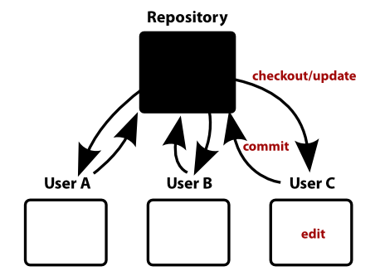

Slide 4


Slide 5



Slide 6


Slide 7


Slide 8



Slide 9



Slide 10


Slide 11


Slide 12


Slide 13


Slide 14


Slide 15


Slide 16
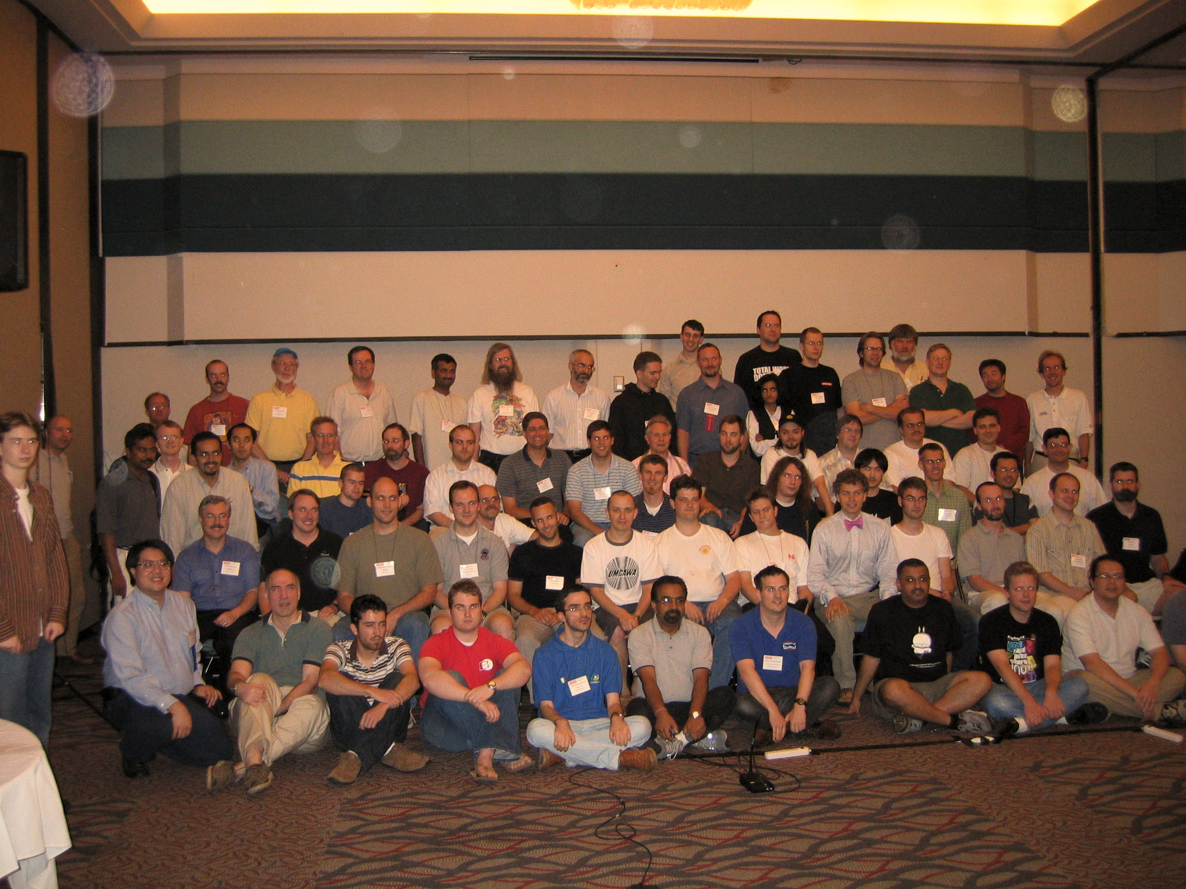

Slide 17


Slide 18


Slide 19


Slide 20


Slide 21


Slide 22



Slide 23


Slide 24


Slide 25


Slide 26
“
In many ways you can just see git as a filesystem — it's content-addressable, and it has a notion of versioning, but I really really designed it coming at the problem from the viewpoint of a filesystem person (hey, kernels is what I do), and I actually have absolutely zero interest in creating a traditional SCM system. “

Slide 27

“
In many ways you can just see git as a filesystem — it's content-addressable, and it has a notion of versioning, but I really really designed it coming at the problem from the viewpoint of a filesystem person (hey, kernels is what I do), and I actually have absolutely zero interest in creating a traditional SCM system. “

Slide 28
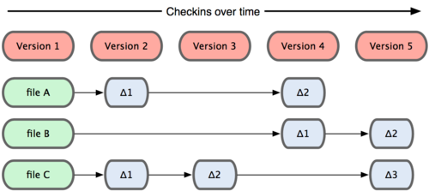
Traditional Source Controls

Slide 29
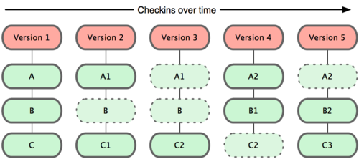
Git

Slide 30
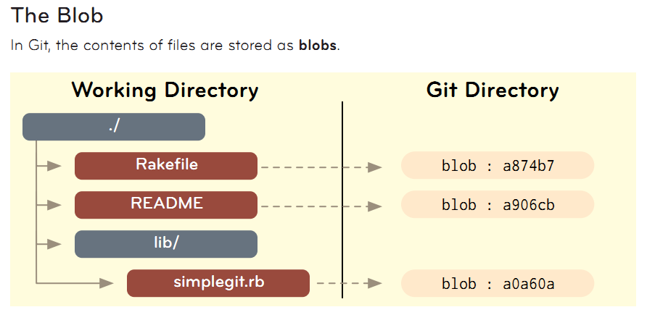
Git Internals

Slide 31
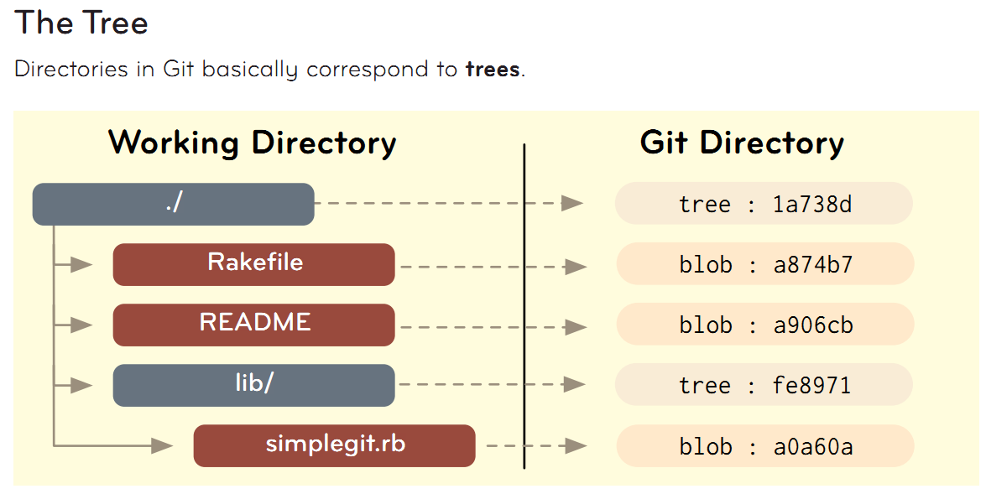
Git Internals

Slide 32
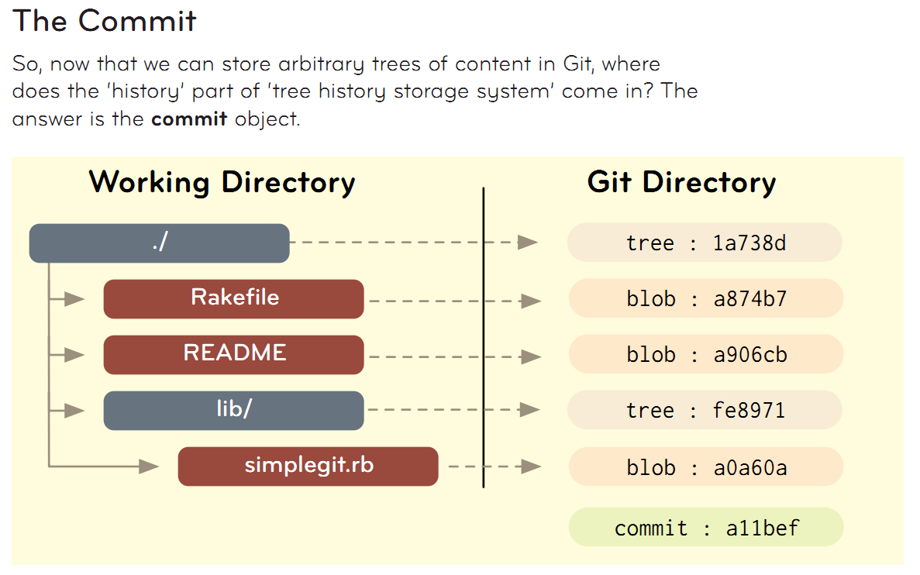
Git Internals

Slide 33
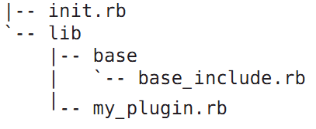

Slide 34
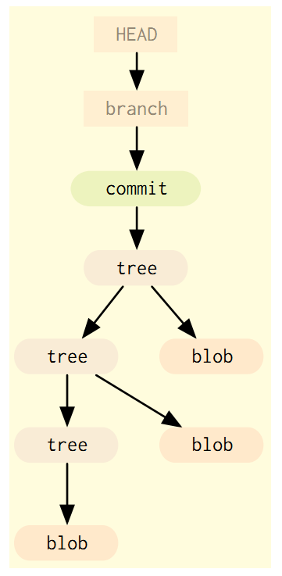

Slide 35
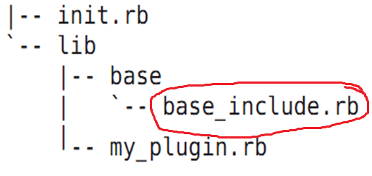
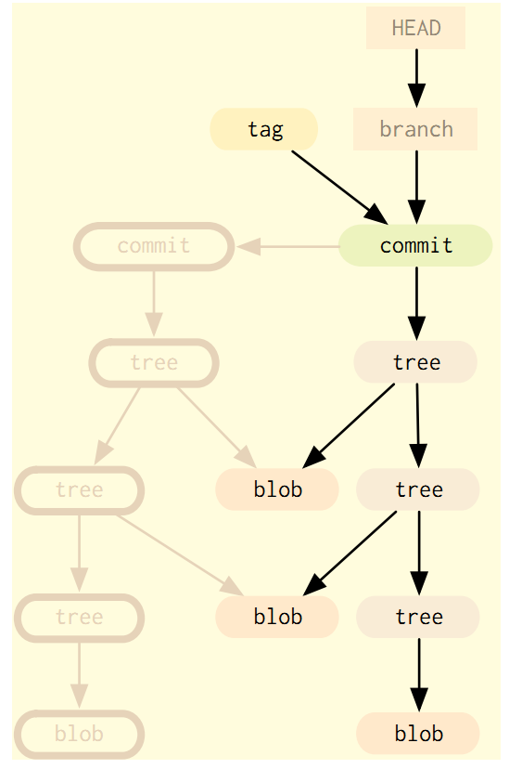

Slide 36
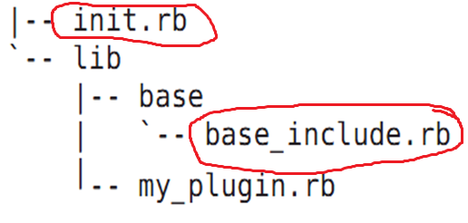

Slide 37
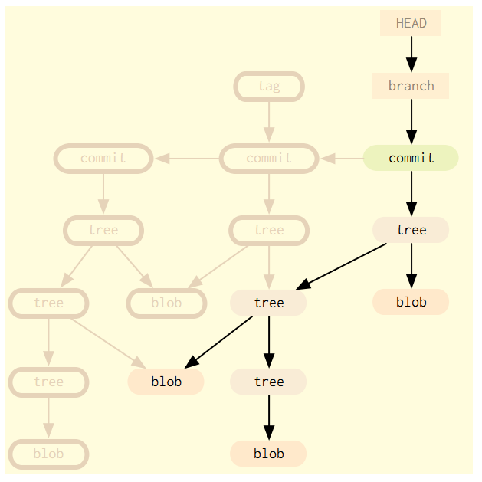

Slide 38
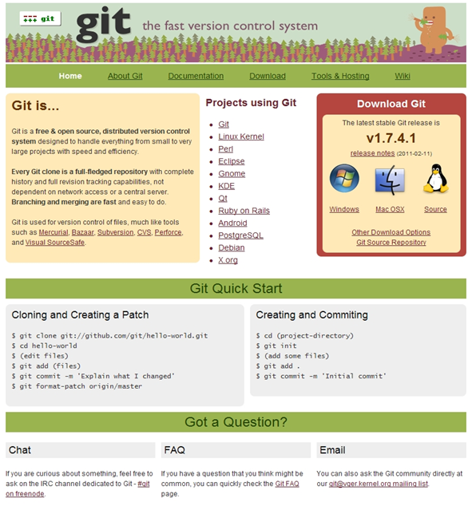
Installation

Slide 39
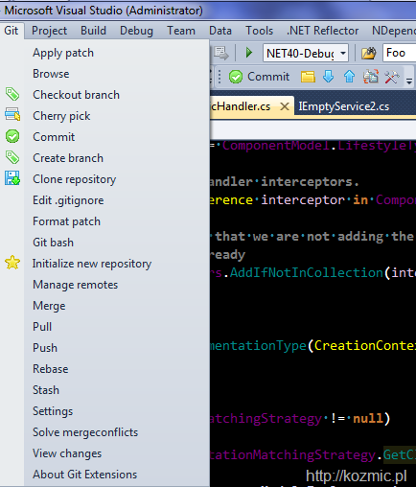
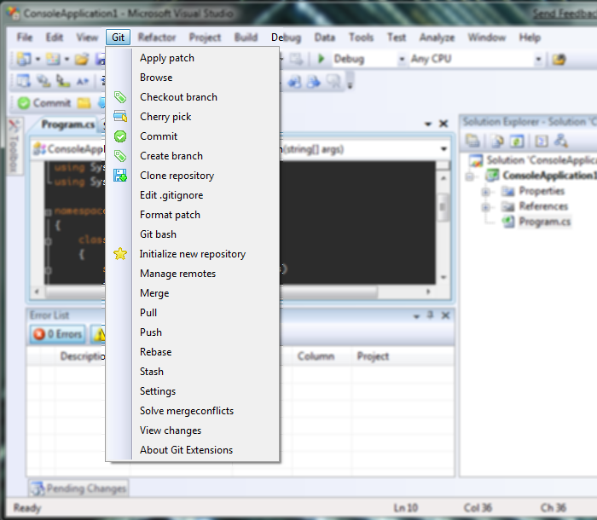

Slide 40
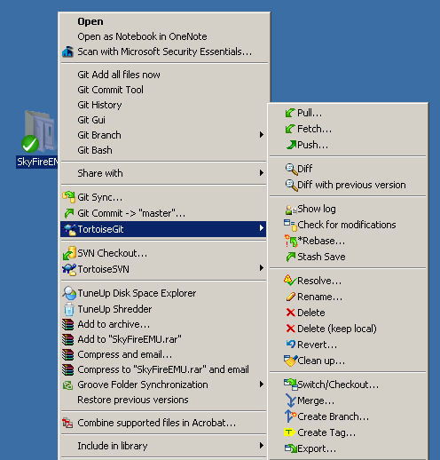

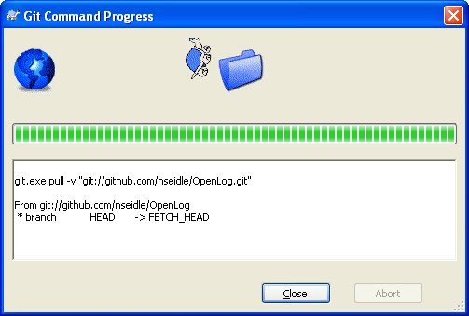

Slide 41
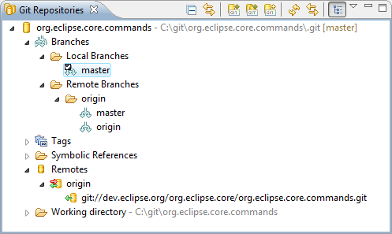
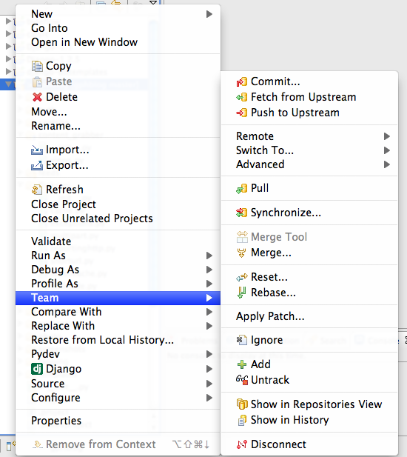

Slide 42

Creating a new repository

Slide 43

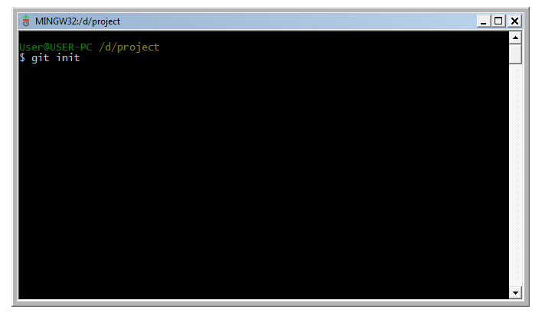

Slide 44
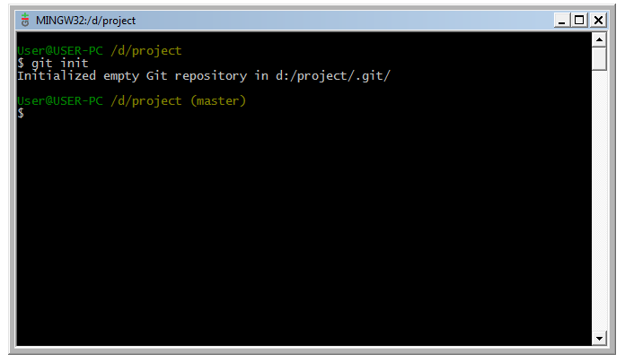

Slide 45
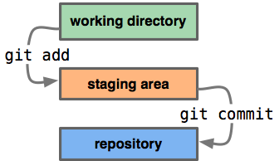

Slide 46


Slide 47
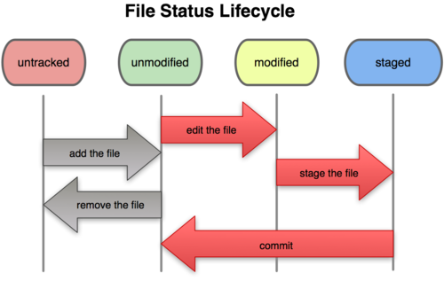

Slide 48


Slide 49

Branching

Slide 50
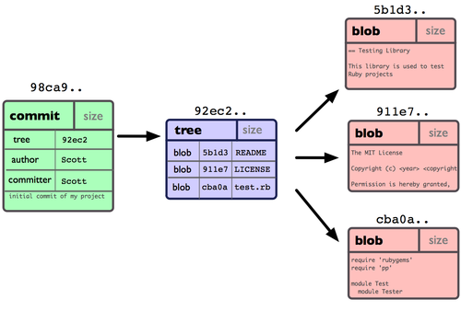

Slide 51
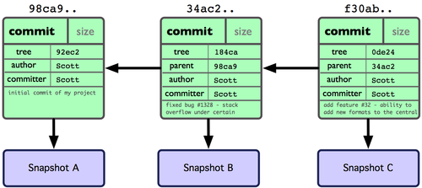

Slide 52
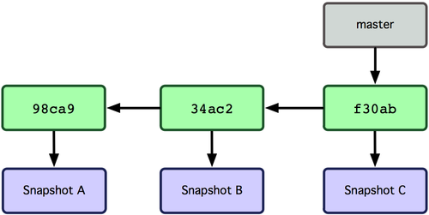

Slide 53
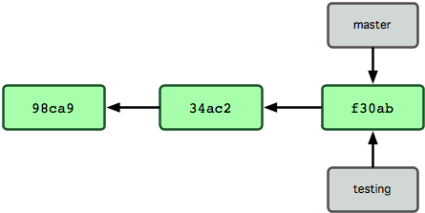

Slide 54
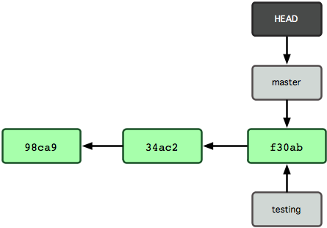

Slide 55
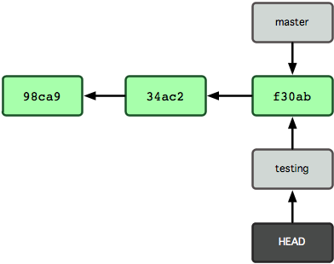

Slide 56
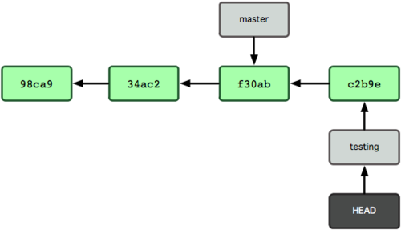

Slide 57
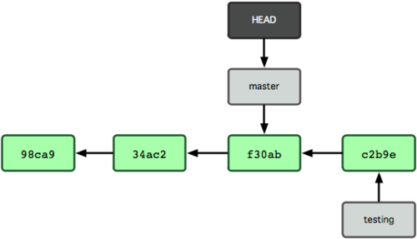

Slide 58
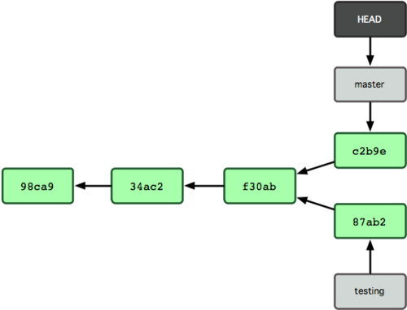

Slide 59
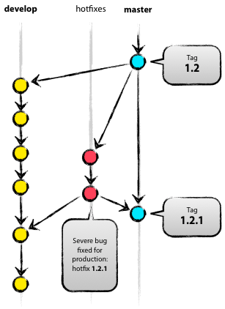

Slide 60
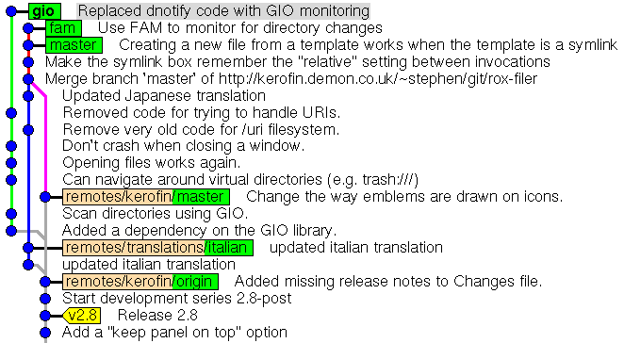

Slide 61
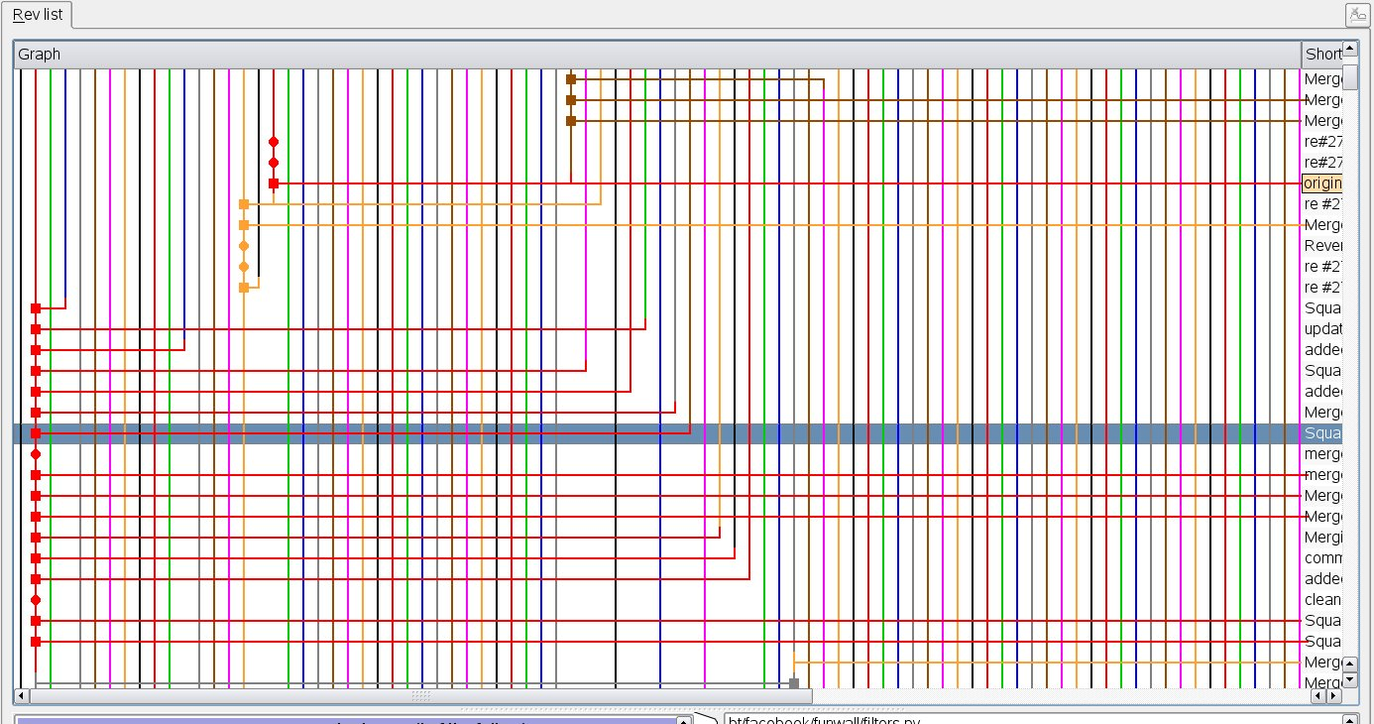

Slide 62
Merging Branches

Slide 63
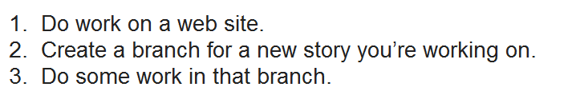

git merge

Slide 64
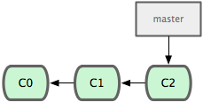

Slide 65
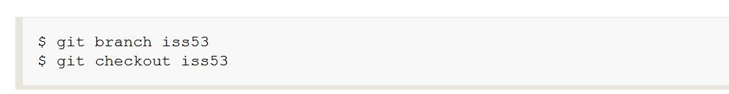

Slide 66
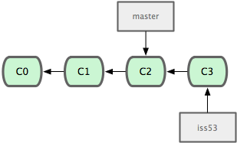

Slide 67


Slide 68
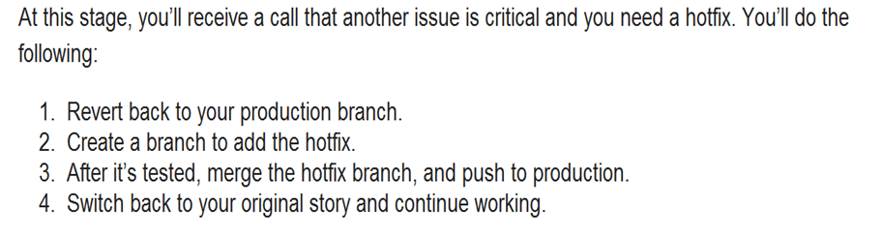

Slide 69
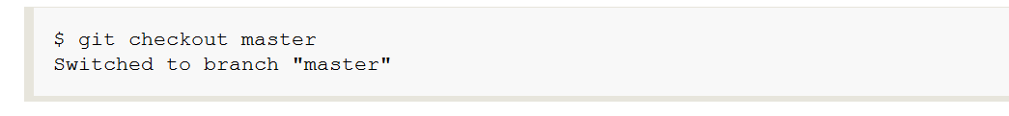

Slide 70
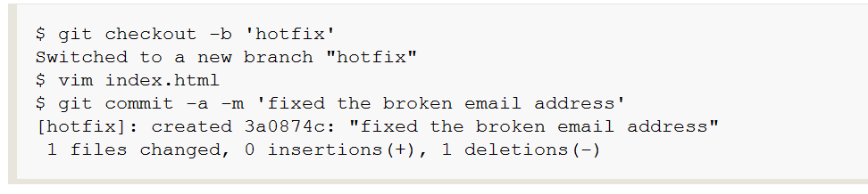
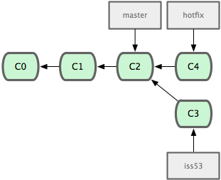

Slide 71
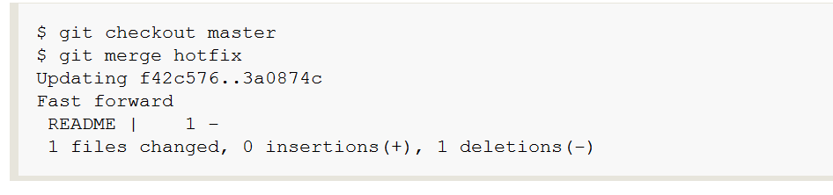
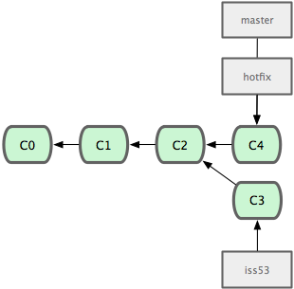

Slide 72


Slide 73
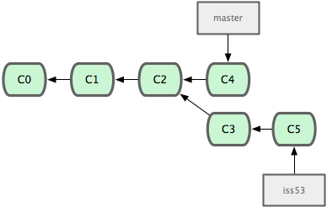

Slide 74
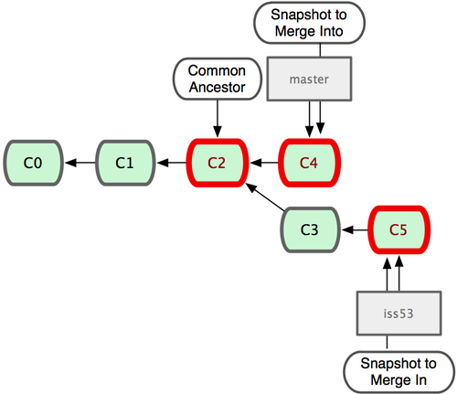

Slide 75
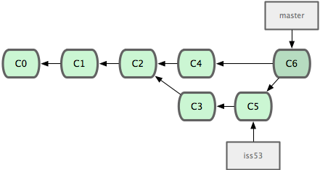

Slide 76
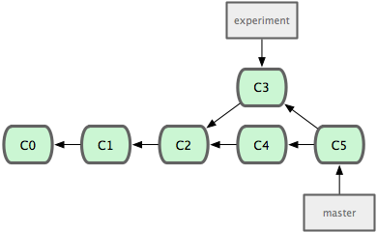
git rebase

Slide 77


Slide 78


Slide 79


Slide 80

Merge
Conflicts

Slide 81


Slide 82

Remote
Repositories

Slide 83


Slide 84


Slide 85


Slide 86



Slide 87


Slide 88



Slide 89


Slide 90


Slide 91


Slide 92


Slide 93


Slide 94


Slide 95






Slide 96


Yaron.Wittenstein@gmail.com

